Slide 1

8th Grade Math: Pre-Algebra
Unit 5, Lesson 8 Triangles on the Coordinate Plane Volume 1, pg. 215

Slide 2


Benchmark
MA.8.GR.1.2
Apply the Pythagorean Theorem to solve mathematical and real-world problems involving the distance between two points in a coordinate plane.
volume 1, pg. 215

Slide 3
Integrated Mathematical Thinking and Reasoning Standards
MA.K12.MTR.1.1 Actively participate in effortful learning both individually and collectively.
MA.K12.MTR.3.1 Complete tasks with mathematical fluency.
MA.K12.MTR.4.1 Engage in discussions that reflect on the mathematical thinking of self and others.
MA.K12.MTR.5.1 Use patterns and structure to help understand and connect mathematical concepts.
volume 1, pg. 215

Slide 4

Learning Targets
I can determine the horizontal and vertical lengths of a triangle on a coordinate plane.
I can determine the hypotenuse length of a triangle on the coordinate plane.
volume 1, pg. 215

Slide 5

Warm-Up
volume 1, pg. 215

Slide 6
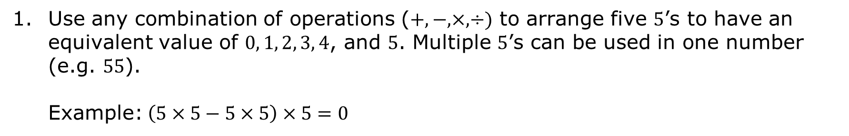
5.8.1 Warm-Up: Critical Thinking
Use any combination of operations ($+,−, ×,÷)$ to arrange five $5$’s to have an equivalent value of $0, 1, 2, 3, 4$, and $5$. Multiple $5$’s can be used in one number (e.g. $55$). Example:$\left(5×5−5×5\right)×5=0$
0 = | 3 =
1 = | 4 =
2 = | 5 =
volume 1, pg. 215

Slide 7

Guided Instruction
volume 1, pg. 216

Slide 8
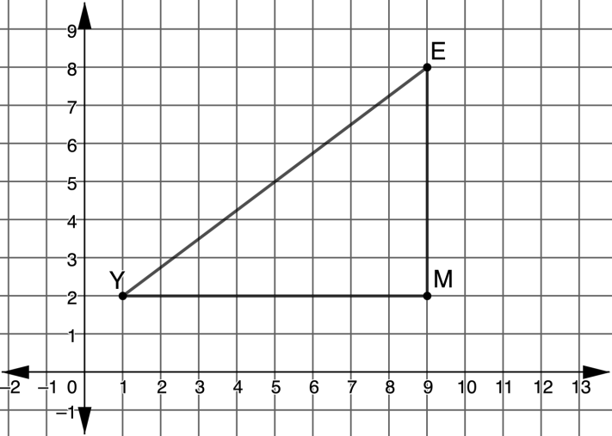

5.8.2 Guided Instruction: Finding the Length
The Triangle $EMY$ is shown on the coordinate plane.
List the ordered pairs for each vertex.
Point $E$ (____, ____)
Point $M$ (____, ____)
Point $Y$ (____, ____)
What is the length of the horizontal leg of Triangle $EMY$?
volume 1, pg. 216

Slide 9
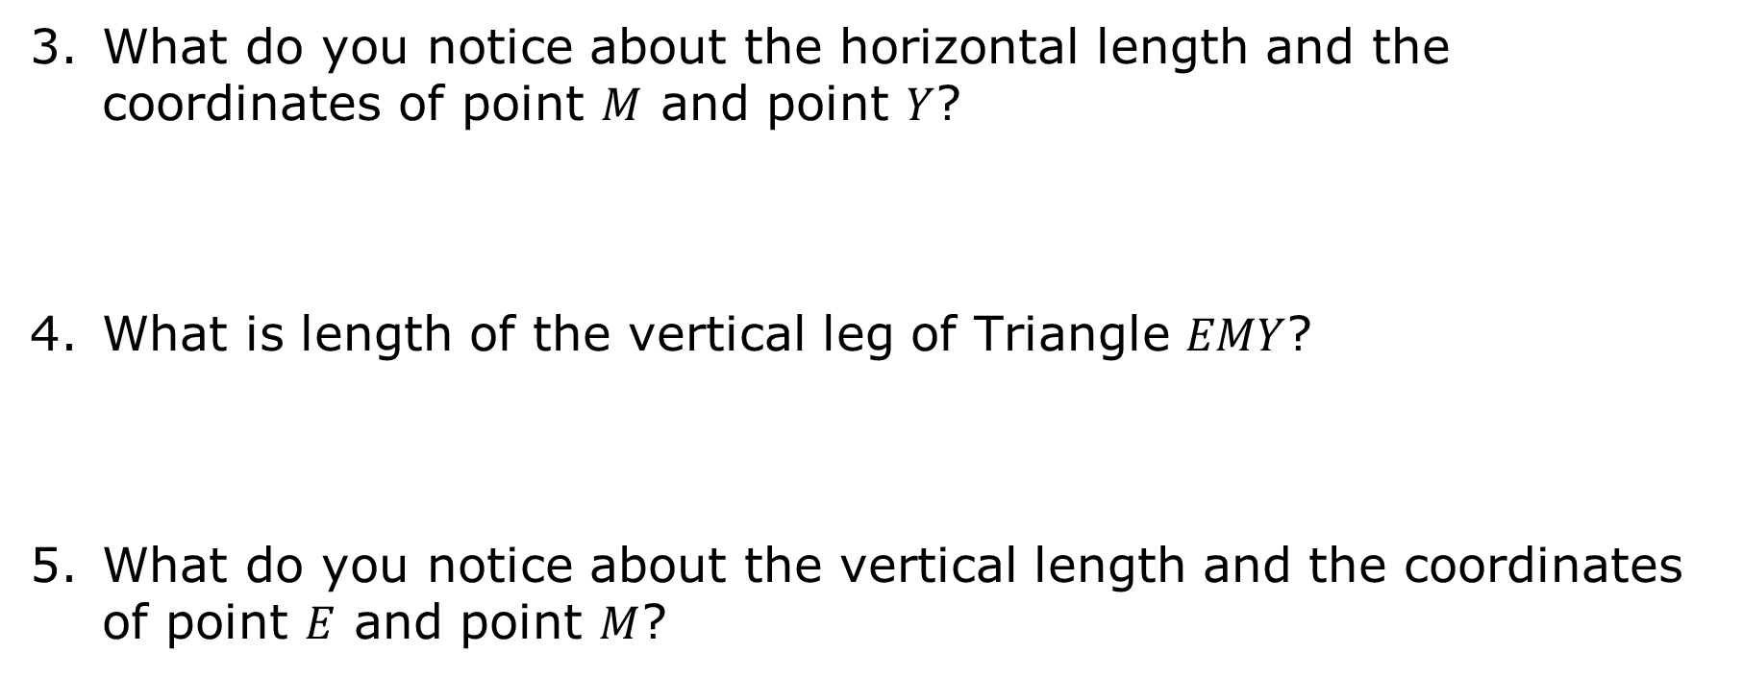
What do you notice about the horizontal length and the coordinates of point $M$ and point $Y$?
What is length of the vertical leg of Triangle $EMY$?
What do you notice about the vertical length and the coordinates of point $E$ and point $M$?
volume 1, pg. 216

Slide 10
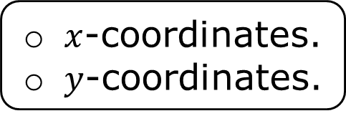
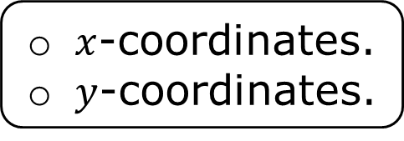
Complete the statements. To determine horizontal length on the coordinate plane, find the difference between the
To determine vertical length on the coordinate plane, find the difference between the
$x$-coordinates.
$y$-coordinates.
$x$-coordinates.
$y$-coordinates.
volume 1, pg. 216

Slide 11

Try It
volume 1, pg. 217

Slide 12

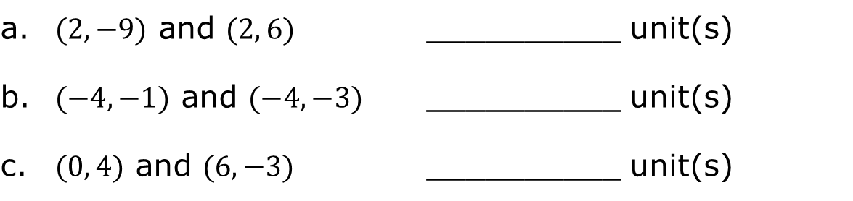
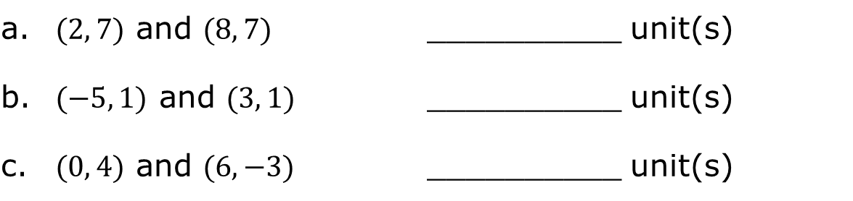
5.8.3 Try It: Finding Horizontal and Vertical Distances
Find the horizontal distance between the following points.
Find the vertical distance between the following points.
a. $(2, 7)$ and $(8, 7)$ | __________ unit(s)
b. $(−5, 1)$ and $(3, 1)$ | __________ unit(s)
c. $(0, 4)$ and $(6, −3)$ | __________ unit(s)
a. $(2,−9)$ and $(2, 6)$ | __________ unit(s)
b. $(−4,−1)$ and $(−4, −3)$ | __________ unit(s)
c. $(0, 4)$ and $(6, −3)$ | __________ unit(s)
volume 1, pg. 217

Slide 13
Guided Instruction
volume 1, pg. 217

Slide 14
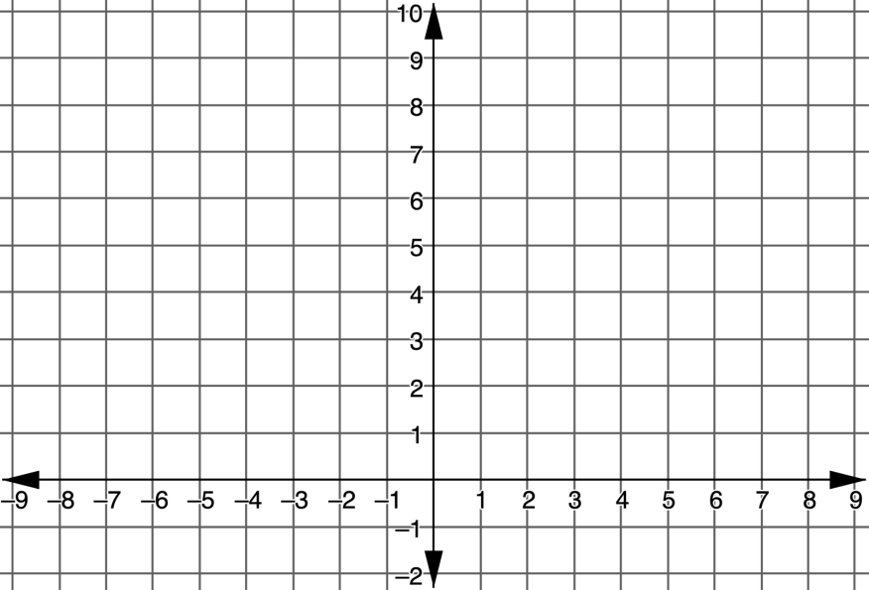
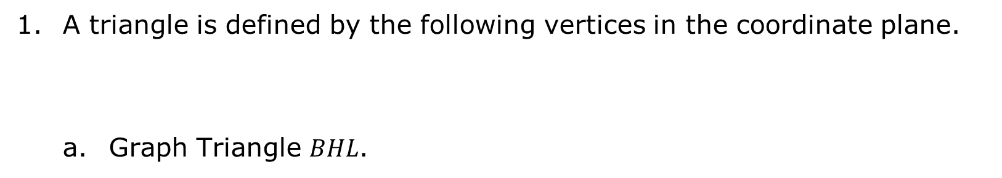
5.8.4 Guided Instruction: Right Triangles on the Coordinate Plane
A triangle is defined by the following vertices in the coordinate plane.
Graph Triangle $BHL$.
Point$B (8, 3)$ | Point $H (−2, 3)$ | Point $L (8, 7)$
volume 1, pg. 217

Slide 15
Find the length of the horizontal leg and label the leg with its length.
Find the length of the vertical leg and label the leg with its length.
volume 1, pg. 217

Slide 16
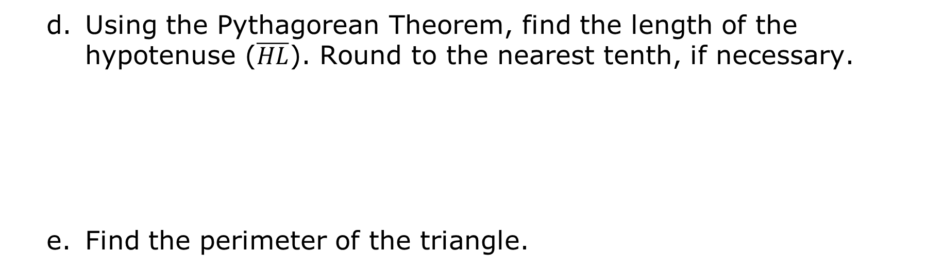
Using the Pythagorean Theorem, find the length of the hypotenuse ($\overline{HL}$). Round to the nearest tenth, if necessary.
Find the perimeter of the triangle.
volume 1, pg. 218

Slide 17
Try It
volume 1, pg. 218

Slide 18
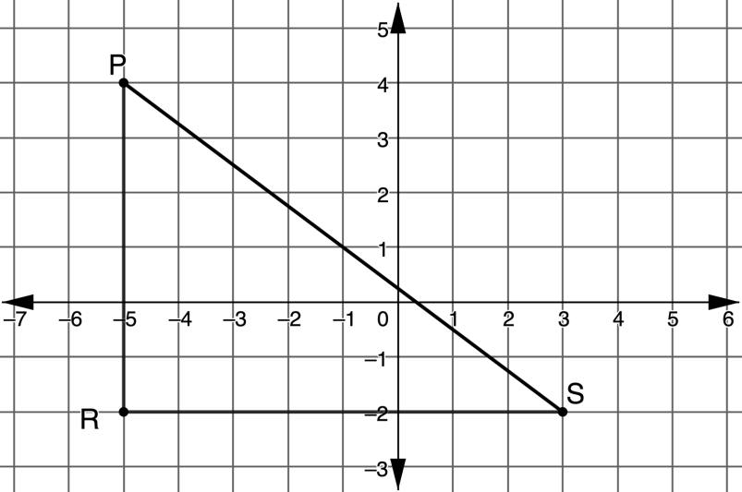

5.8.5 Try It: Right Triangles on the Coordinate Plane
Triangle $PRS$ is graphed on the coordinate plane.
Find the perimeter of Triangle $PRS$. Round to the nearest tenth, if necessary.
volume 1, pg. 218

Slide 19

Guided Practice
volume 1, pg. 219

Slide 20

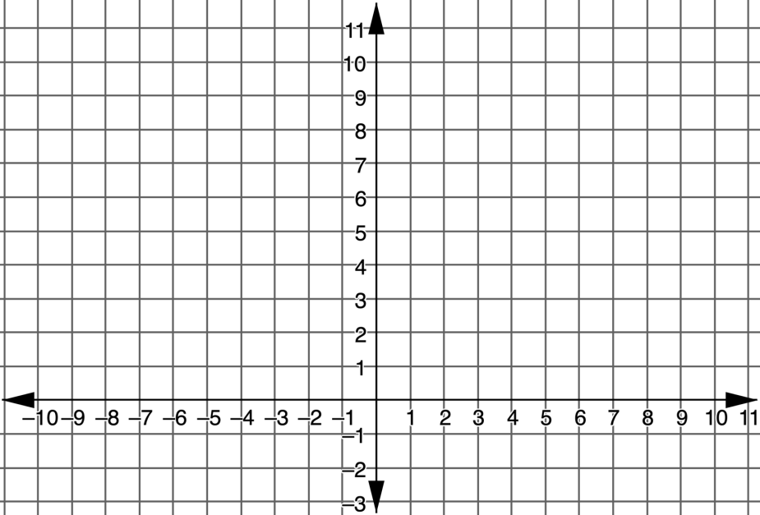
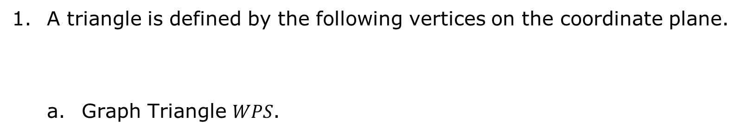
5.8.6 Guided Practice: Finding Perimeter
A triangle is defined by the following vertices on the coordinate plane.
Graph Triangle $WPS$.
Point$W (−4, 2)$ | Point $P (8, 2)$ | Point $S (2, 10)$
volume 1, pg. 219

Slide 21
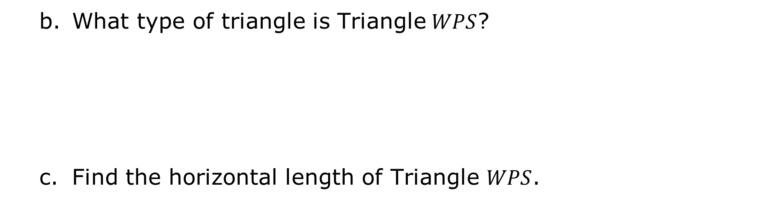
What type of triangle is Triangle$WPS$?
Find the horizontal length of Triangle $WPS$.
volume 1, pg. 219

Slide 22
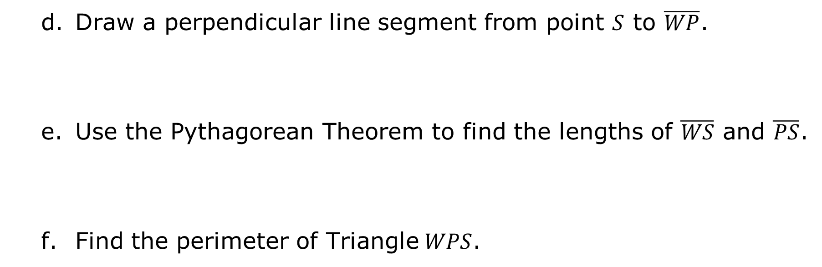
Draw a perpendicular line segment from point $S$ to $\overline{WP}$.
Use the Pythagorean Theorem to find the lengths of $\overline{WS}$ and $\overline{PS}$.
Find the perimeter of Triangle$WPS$.
volume 1, pg. 219

Slide 23

Your Turn
volume 1, pg. 220

Slide 24
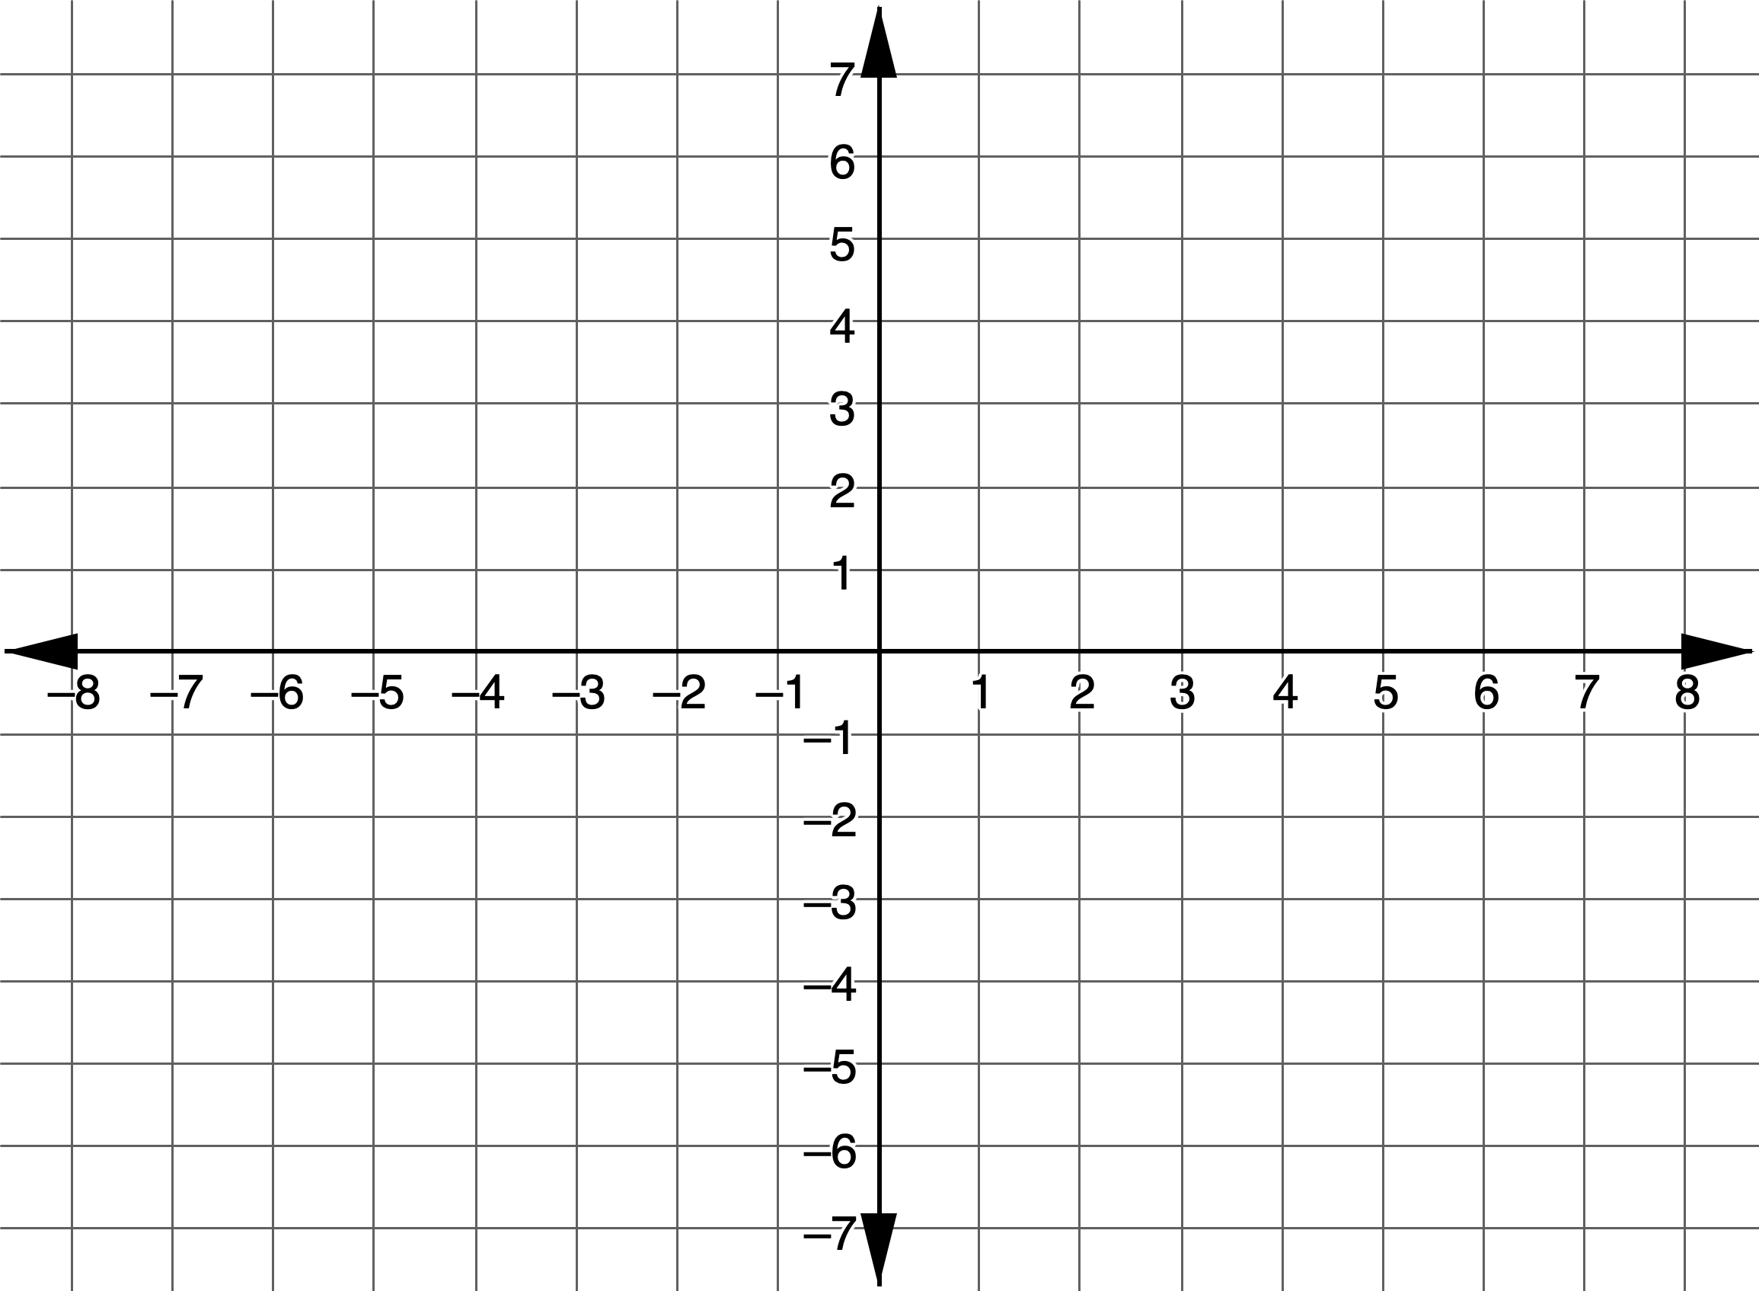

5.8.7 Your Turn!
Triangle $DKF$ is defined by the following vertices.
Graph Triangle $DKF$.
Label each side with its length. Round to the nearest tenth, if needed.
$$D (−1,0)$$ | $$K (2,−6)$$ | $$F (2,0)$$
volume 1, pg. 220

Slide 25
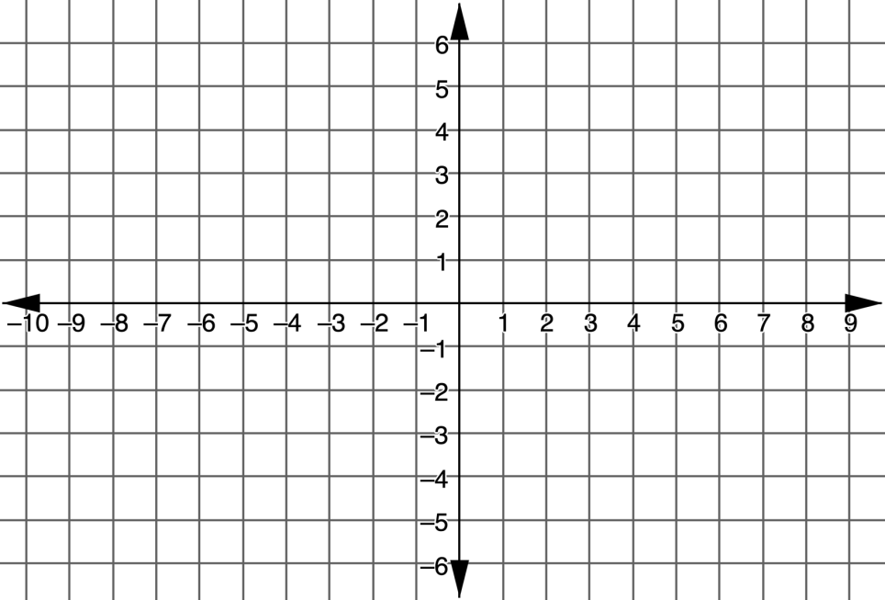
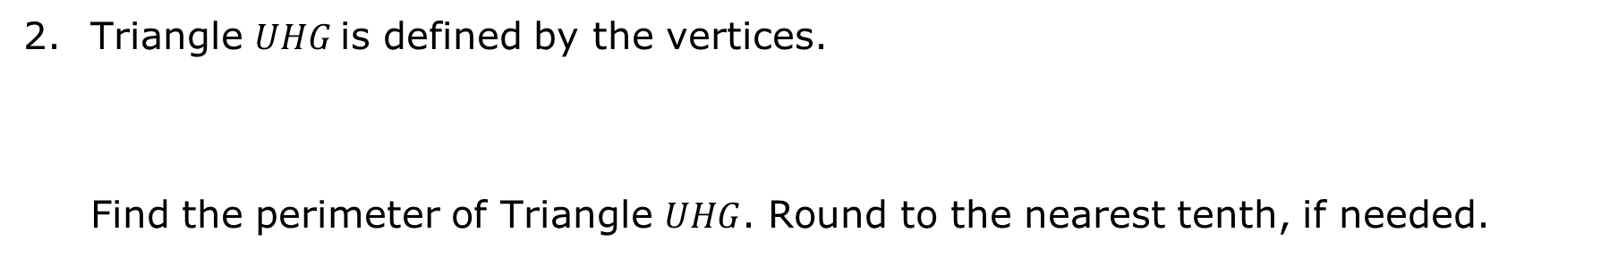
Triangle $UHG$is defined by the vertices.
Find the perimeter of Triangle $UHG$. Round to the nearest tenth, if needed.
$$U (−9, 3)$$ | $$H (6, 3)$$ | $$G (3, −5)$$
volume 1, pg. 220

Slide 26

Wrap-Up
volume 1, pg. 221

Slide 27
5.8.8 Wrap-Up: Reflection
Place an X on each line to indicate your understanding of each success criteria.
Success Criteria | Self-Assessment
I can apply the Pythagorean Theorem to find the distance of a segment on the coordinate plane. | I need help. I can’t get started. | I’m getting there. | I understand and I have evidence.
volume 1, pg. 221

Slide 28
Success Criteria | Self-Assessment
I can find the perimeter of a right triangle on the coordinate plane. | I need help. I can’t get started. | I’m getting there. | I understand and I have evidence.
volume 1, pg. 221

